Slide 1
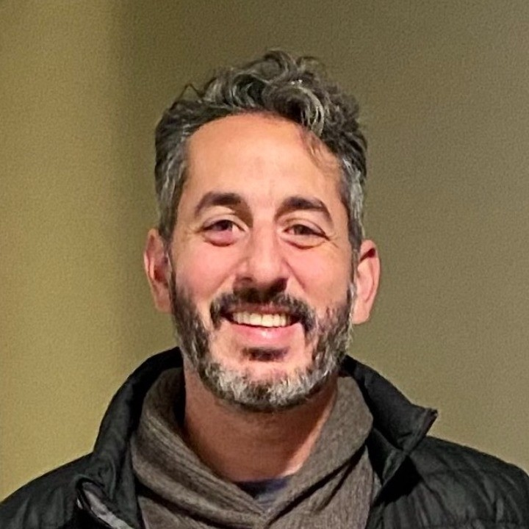
Yoni Degani Senior Manager — Acceleration
Email
Yoni.degani@thebridge.com
Location
DFW, Texas
Mobile
(214) 534-2444
Yoni joined The Bridge in August 2023. He has previously led Agile practice adoption across a wide range of industries and clients while developing high-performing teams that deliver technology solutions both co-located as well as remote. He is keen on using data and visualizations to inspire change and inform decision making.
EXPERIENCE
Industry Experience
Retail | Data Science | Insurance | Automotive | Government / Defense | Gaming | Logistics
Agile Transformation | Data Science / Auto Insurance
Led Agile Transformation for a data science-driven insurance provider.
Partnered with Executive stakeholders to design portfolio management processes and SDLC strategies that deliver early and continuous value to our customers.
Designed the transition from silo’d functional teams to cross-functional agile teams and the product value streams that they align to.
Retail Inventory Management | Retail
Agile Lead and Coach, leading a portfolio of scrum teams that focused on enabling more efficient inventory management workflows and replenishment experiences, increasing global revenue by ~$60M / year.
Established an Agile Community of Practice which grew from 10 members to 30+ across multiple countries.
BACKGROUND
Functional Skills
Agile Coaching and Leadership, Program Management, Enterprise Agile Transformation & Innovation, Process Design / Optimization, Product Management, Scrummaster
Qualifications
Certified SAFe 6 Practice Consultant (SPC)
Agile Certified Practitioner (ACP)
Certified Scrummaster (CSM)
Certified DSDM Practitioner (DSDM)

Slide 2

Email
Yoni.degani@thebridge.com
Location
DFW, Texas
Mobile
(214) 534-2444
Yoni joined The Bridge in August 2023. He has previously led Agile practice adoption across a wide range of industries and clients while developing high-performing teams that deliver technology solutions both co-located as well as remote. He is keen on using data and visualizations to inspire change and inform decision making.
Yoni Degani Senior Manager
Acceleration

